Slide 1
Laravel 6 Workshop

Slide 2
Before I begin…
Introduce yourself!
Name
Hobbies
Programming languages used
How do you imagine your career after graduation?

Slide 3

Speaker Information
Tricia Jasmine Moreno
Work Experience
Associate Software Engineer
Accenture
April 2019 – present
Technology Consultant
DXC
July 2018 – January 2019
Intern
Stratworth Solutions, Inc.
August – November 2017
Education
Master of Information Technology
Adamson University
August 2019 - present
BS Computer Science
University of Santo Tomas
2014-2018

Slide 4
Speaker Information
Programming languages used:
C
C++
C#
Java
Javascript
PHP
Python
PL/SQL
Frameworks & Libraries used:
[Javascript]
jQuery
Vue.js
Angular
[PHP] - Laravel
[Python] - Django
Extracurricular Achievements:
2nd runner-up
Code Sprint 2018
University of Santo Tomas
1st runner-up
AppJam 2017
University of Santo Tomas
2nd runner-up
IBM Hack-a-superpower (2016)
SMX Convention Center
Things I’ve been planning to learn lately:
Revisit machine learning
Learn more about Natural Language Processing
Learn more about Penetration testing
Learn more about React

Slide 5
What is Laravel?
Background, Concepts, & Getting started

Slide 6

What is Laravel?
Laravel was created by Taylor Otwell in 2011
It is a PHP web framework intended for creating web applications in an MVC pattern
Laravel is free and open-source
Currently, Laravel is at its version 6

Slide 7
Laravel Features
Model-View-Controller architecture
Object-Relational Mapping using Eloquent
Database migration
Authentication
Password hashing
Blade Template Engine
Routing

Slide 8
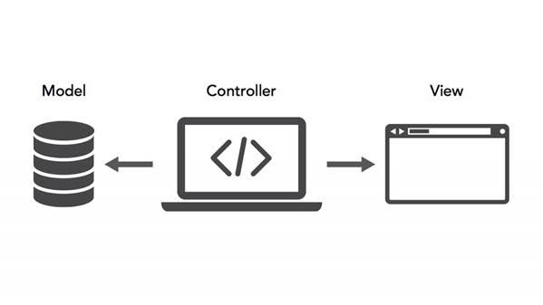
Model-View-Controller Architecture
Model – a model of the data/database of the application
View – what the user sees; the UI of the application
Controller – business logic of the application; handles form events and communicates with the Model

Slide 9
Object-Relational Mapping
ORM is the process of mapping/converting an object into a relational database (a table, for example).
In Eloquent ORM, each database table has a corresponding “Model” which is used to interact with the table.
Eloquent ORM also allows select, insert, update, delete without the need for SQL queries

Slide 10
Database Migrations
Allow easy modification of database schema between team members
Modifies database schema (table structure) without the need for manually tinkering with the database vendor
Also easily creates tables in the database

Slide 11
Authentication
Laravel provides built-in user authentication
Built-in login/logout feature
Automatically retrieves authenticated user

Slide 12
Let’s start coding!
Simple Notes application using Laravel

Slide 13
Code and instructions will be posted on: https://github.com/trishmoreno02/NotesApp

Slide 14
Take-Home Activity
Create any CRUD application using Laravel
Group yourselves in 3-5 members
Be creative!

Slide 15

Don’t forget to download Kahoot!
Winners get special prizes ☺

